Slide 1
SAFETY EDUCATION AND TRAINING
Unit –I
Module 5

Slide 2
TRAINING OF Personnel -
Education deal primarily with broadening knowledge and understanding
Training deals with the development of skill in performance
Education and Training needed to develop safe work techniques and practices
Problem in industry
Communication
Top management
Supervisor
Man on the job
Information has to pass from
Motivation is a factor – directions and controlling activities
From motivation, employees will work hard- for quality, courtesy and safety
Prepared for the training program

Slide 3
SAFETY EDUCATION AND TRAINING
Safety
Quality and scheduling
Production
Efficiency
Safety, quality, scheduling, efficiency and Employee relations is implemented through efforts of foreman and supervisors
After foreman and supervisors are properly trained
Then subordinates are trained and motivated

Slide 4
Employee training procedure
Systematic training of employees is necessary
Training may be given by the Foreman or supervisor responsible for the job
Training specialists needed for large plants for general training and set up a procedure
Specialists prepare training manuals and they conduct the program and supervises the activity in individual dept.

Slide 5
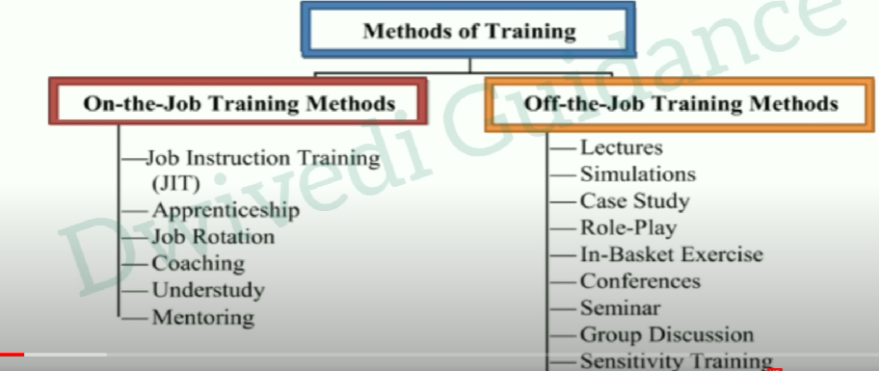

Slide 6

Methods followed in chemical plants
Vestibule instruction:
This is a plan to teach specialised, general or advanced techniques peculiar to the industry before the employee actually starts with:
On – the – Job training
On-the-job training, also known as OJT, is a hands-on method of teaching the skills, knowledge, and competencies needed for employees to perform a specific job within the workplace. Employees learn in an environment where they will need to practice the knowledge and skills obtained during their training.

Slide 7
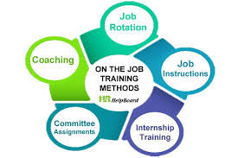

On – the – Job training
LEARNING BY DOING
Job training acquaints the employee with a new job or teaches him additional skills
Dept. supervisors takes time to train whenever it is required, this applies to new operations, new employees and changes in equipments.
A changed job is considered as new one and breaking-in is required
Good Instructor qualities
- Friendly
- sincere
- patient
- thorough working knowledge of the job to be taught
- Knows the principles of teaching
Ability to breakdown the job into component steps
Use an outline of each assignment
Follow an step-by step analysis of job

Slide 8
Job instructor training(JIT)
Training the workers with simple breakdown of steps, it is easy to understand and complete
During word war II – Govt. realised the need of improved training in industry and sponsored the job instructor training courses known as J.I.T.
How to get ready
To instruct the worker on experienced job or new job
Have a plan (how much skill you expect him to have and how soon)
Analyse the job (list the principal steps, pick out key points)
Have everything ready (right tool, equipment and materials)
Have the work place properly arranged (just as worker will be expected to keep it)

Slide 9
How to instruct
Step 1- Prepare (Find out what he already knows about the job, get him interested and anxious)
Step 2 – Present (Tell him, show him, illustrate, ask questions carefully, stress the key points
Step 3 – Perform (Test him by having him to perform the job, observe the performance and check for errors)
Step 4 – Follow up (put him on his own, check frequently, extra coaching and close follow up until he fits for the job)
Breaking down the job into component parts
JOB BREAKDOWN SHEETS for training men and new job

Slide 10
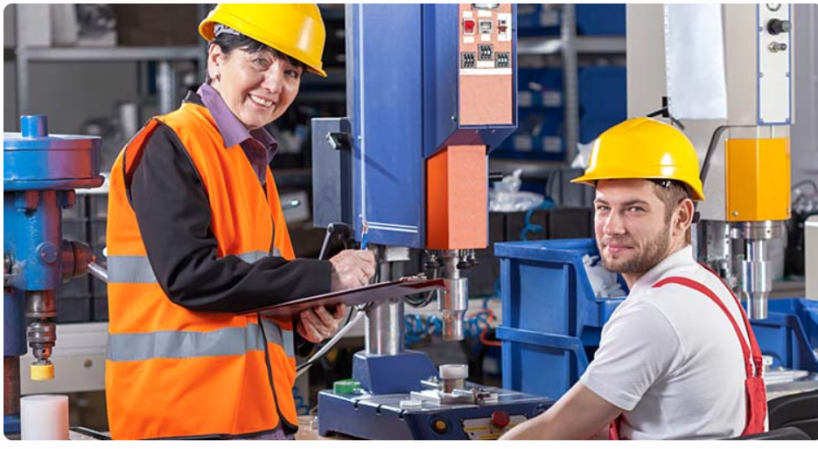
Training –on –the-job
On – the job- training is the best method – presenting a full, clear and actual picture of the work
Group trainings
- small discussion groups
Meetings and Instructional presentations
- meeting place should be adequate in space, good illumination, comfortable seats,etc
Do not try to cover too many subjects in one session

Slide 11
Other training methods
Apprenticeship
Earning while doing
Experienced persons give training and after completion trainee can apply for permanent job.
Job Rotation
Teaches current employees how to do various jobs over time
Employee will rotate around different jobs within the organisation, performing various different tasks unrelated to his original job
Coaching
More experienced and skilled individuals provides employees with advice and guidance
Understudy
A trainee who is likely to assume duties of his position, currently held by his/her superior is called understudy
Mentoring
Senior experienced person is assigned to act as an advisor/guide. He is responsible to support/feedback to an employee who is under his charge

Slide 12
OFF THE JOB- Learning by gaining knowledge
Lecture
A direct method of instruction that involves a verbal presentation of information by an instructor of large audience
The instructor organises a material and gives toa group of trainees in the form of talk
Simulations
A kind of training created to mirror real-life situations
Duplicate the actual work environment
Case study
A method which provides descriptive situations which stimulate trainees to make decisions
Purpose is to make trainees apply what they know, develop new ideas to manage the situation or solve a problem

Slide 13
Role play
An active learning strategy, Participants will play realistic scenarios under the supervision of a trainer
Group discussions
Sharing ideas or activities. People in the Group discussion are connected with one basic idea, based on his/her idea everyone represents his/her perspective
Syndicates
Participative method which basically dividing the participants into number of groups for the purpose of discussion, in exercise or work on a project
Eg. Two pharma companies may combine their R & D teams by creating syndicate to develop a new drug
Sensitivity Training
Related to sensitivity and emotions
Phycological technique used for intensive group discussion and interaction are uded to increase awareness of individual
Seminars
Worshops
Conferences

Slide 14
Instructional aids
Motion pictures
Slides
Photographs
Posters
Take-home materials
Charts and diagrams
Models
Flannel boards
Display boards
Audible examples

Slide 15
https://www.youtube.com/watch?v=f8hxViZkjXI

